Slide 1
Window Programming 2-3
Keyboard Events
Yuan Ze University

Slide 2
Keyboard events
KeyDown
  When the key is pressed down
KeyPress
  e.KeyChar
  e.KeyCode
  e.KeyValue
KeyUp
  When the key is released up

Slide 3
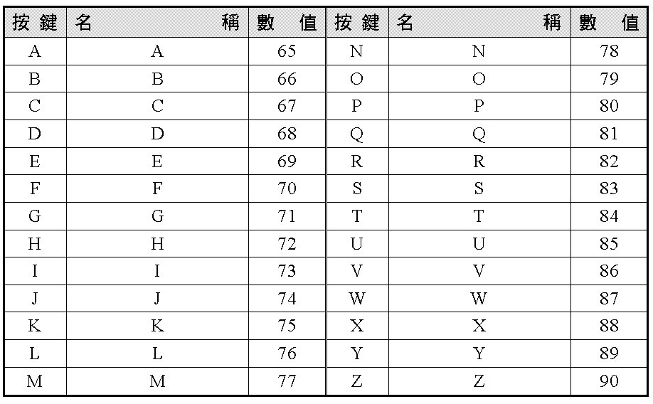
Key codes and values

Slide 4
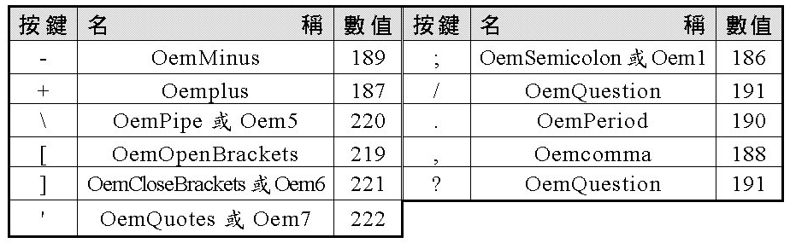
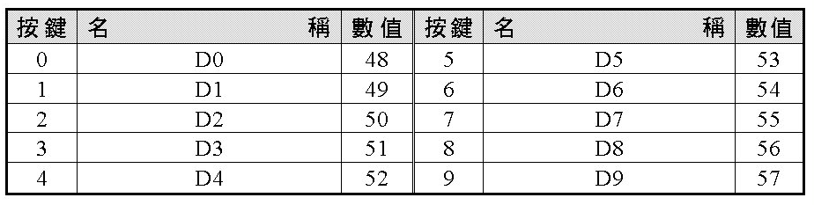
Key codes and values

Slide 5
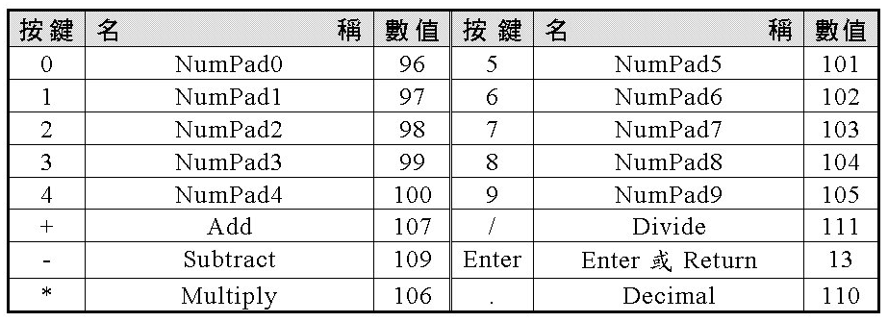
Key codes and values

Slide 6
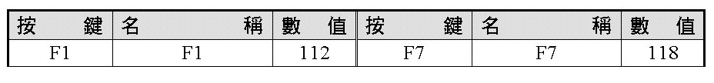
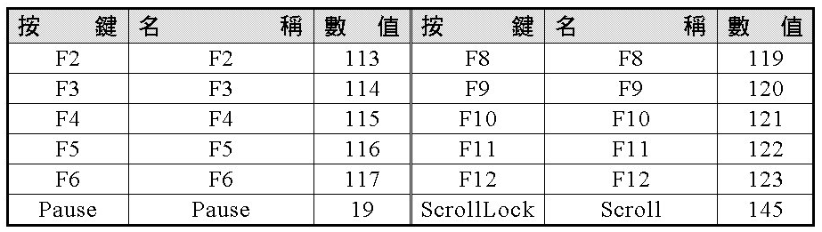
Key codes and values

Slide 7
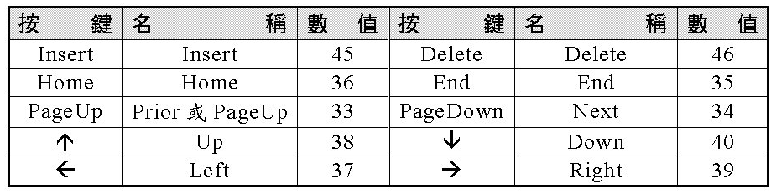

Key codes and values

Slide 8
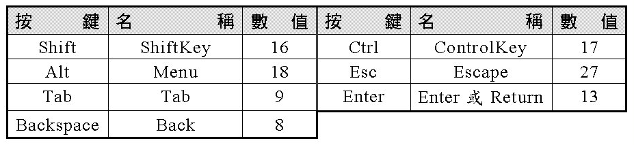
Key codes and values

Slide 9
Keys & IsKeyLocked
Control.IsKeyLocked(Keys.CapsLock)
Control.IsKeyLocked(Keys.NumLock)

Slide 10
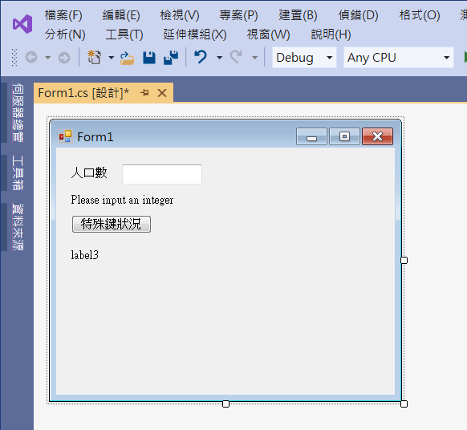
Edit interface
label1
textBox1
label2
button1
label3

Slide 11
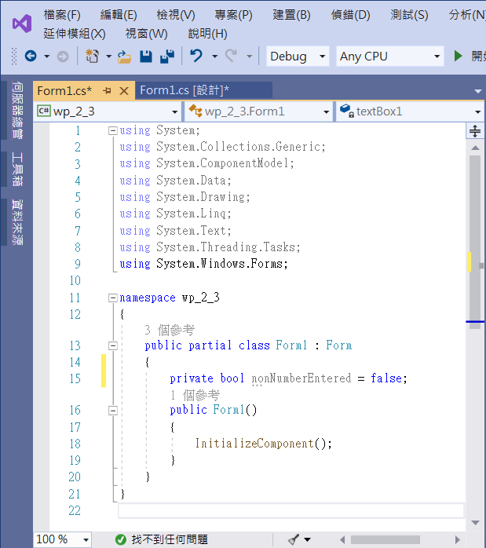
Add a boolean variable
private bool nonNumberEntered = false;
Add a boolean variable

Slide 12
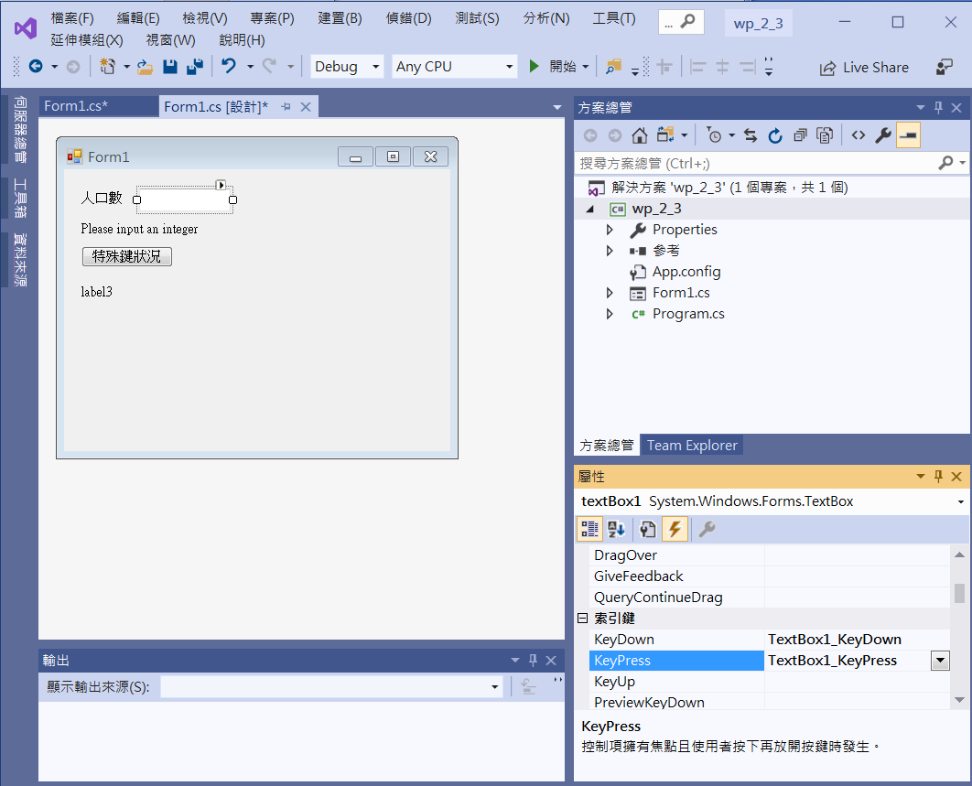
Add event functions
Click at textBox1
Double Click at KeyDown
Double Click at KeyPress

Slide 13
Add event functions
private void textBox1_KeyDown(object sender, KeyEventArgs e)
{
nonNumberEntered = false;
if (e.KeyCode < Keys.D0 || e.KeyCode > Keys.D9) // 鍵盤上數字
{
if (e.KeyCode<Keys.NumPad0 ||e.KeyCode> Keys.NumPad9) //數字盤
{
if (e.KeyCode != Keys.Back) //Backspace
nonNumberEntered = true;
}
}
}

Slide 14
Add event functions
private void textBox1_KeyPress(object sender, KeyPressEventArgs e)
{
if (nonNumberEntered == true)
{
e.Handled = true;
label2.Text = e.KeyChar + " is not a digit. Please input a digit.";
}
else
label2.Text = e.KeyChar + " is OK.";
}

Slide 15
Add event functions
private void button1_Click(object sender, EventArgs e)
{
if (Control.IsKeyLocked(Keys.CapsLock))
label3.Text = "大寫鎖鍵已按下";
else
label3.Text = "大寫鎖鍵已取消";
if (Control.IsKeyLocked(Keys.NumLock))
label3.Text += "\n數字鎖鍵已按下";
else
label3.Text += "\n數字鎖鍵已取消";
}

Slide 16
Add event functions
private void Form1_Load(object sender, EventArgs e)
{
this.ActiveControl=textBox1;
}

Slide 17
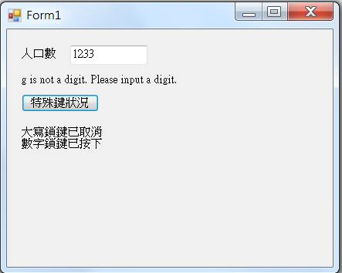
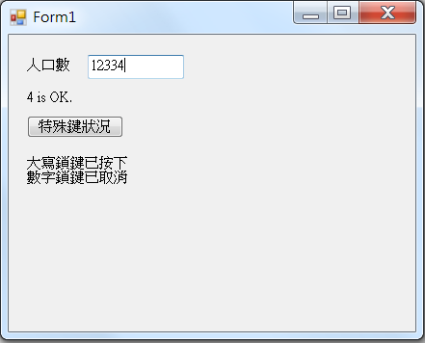
Exercise#2-3

Slide 18
內容來源
  Visual C# 2013視窗程式設計(黃聰明/著; 松崗)
  跟著範例學會Visual C# 2015(張逸中/著; 博碩)

